Slide 1
Accident Severity Prediction & Safety Insights
Data Science & Machine Learning Project Pavan Lade | Intern – Data Science & AI

Slide 2
Business Problem & Objective
Road accidents lead to severe injuries and fatalities
Early prediction of accident severity can help:
Emergency response prioritization
Road safety planning
Policy decisions

Slide 3
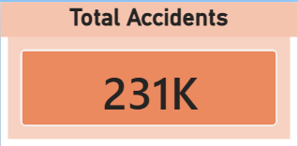
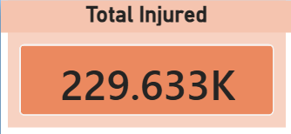
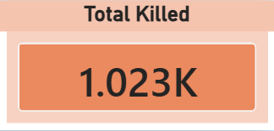
Dataset Overview
Data source: Vehicle Collision Dataset
Total records: 231K accidents
Target variable: Person Injury (Injured / Killed)
Features include:
Person type
Gender
Time, day, month
Safety equipment
Vehicle position
Bodily injury type

Slide 4
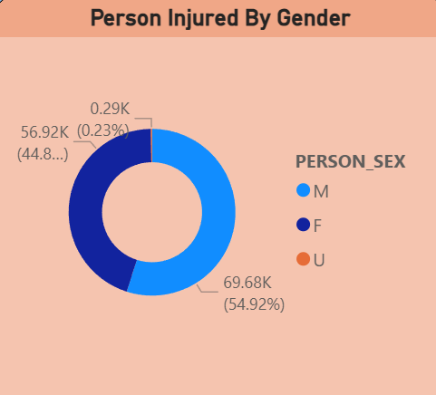
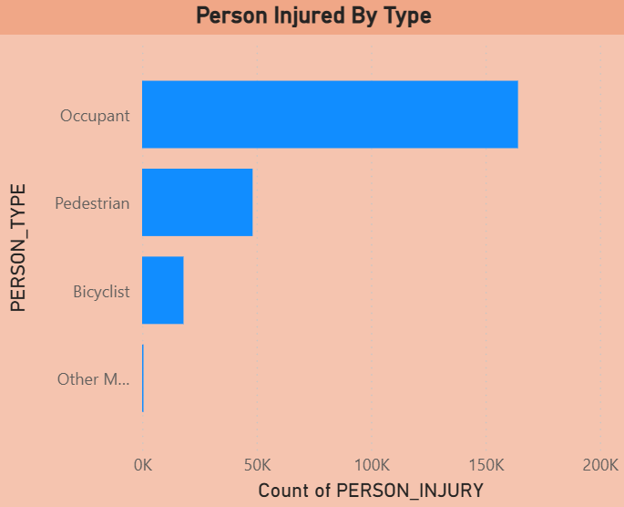
Accident Severity Distribution (Target / Person Injury Analysis)

Slide 5
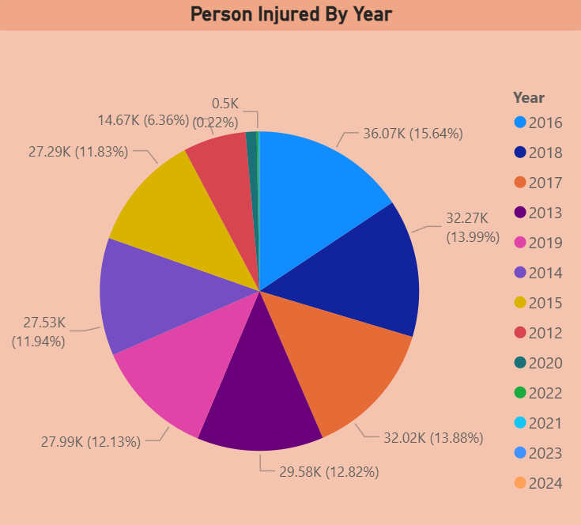
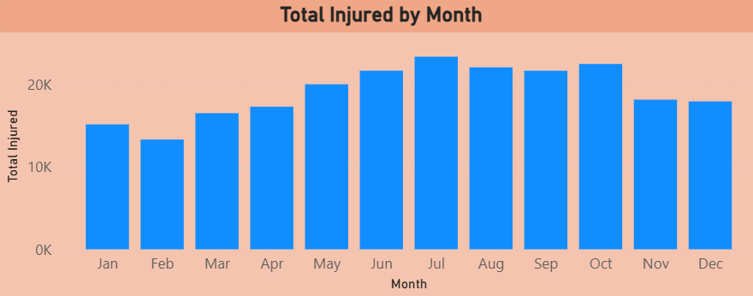
Temporal Analysis (When accidents happen?)
✅ Total Injured by Years ✅ Total Injured by Month

Slide 6
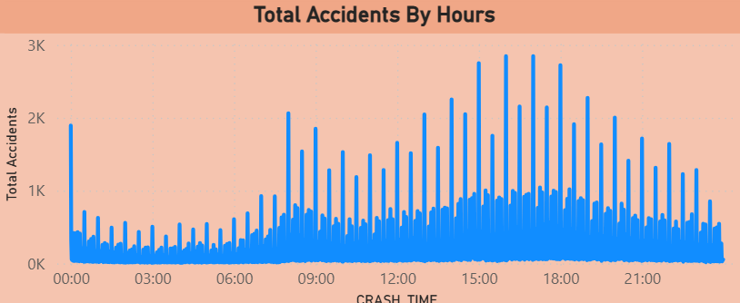
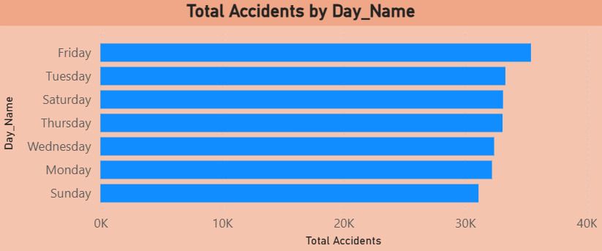
Accident Timing & Day Patterns
✅ Total Accidents by Hours ✅ Total Accidents by Day Name
Peak during evening rush hours (4–8 PM) Friday highest | Sunday lowest

Slide 7
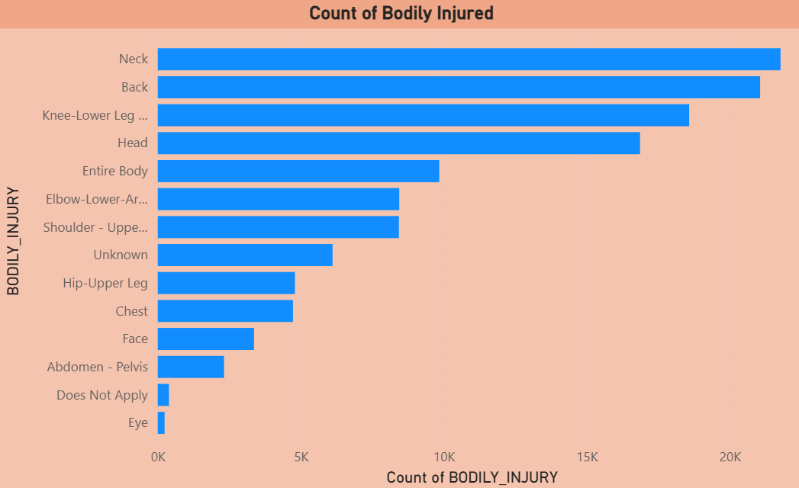
Injury Severity Details
✅ Count of Bodily Injured
Neck, back, head most affected

Slide 8
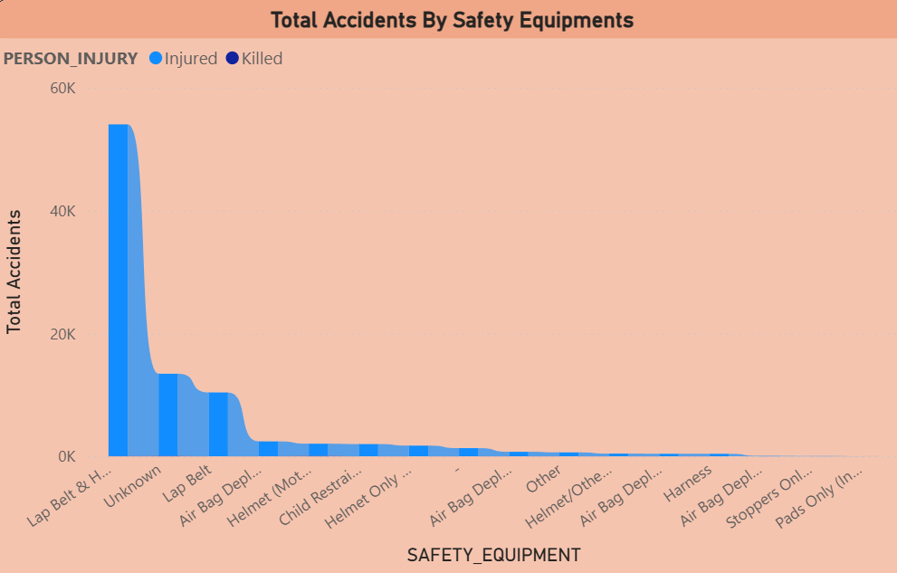
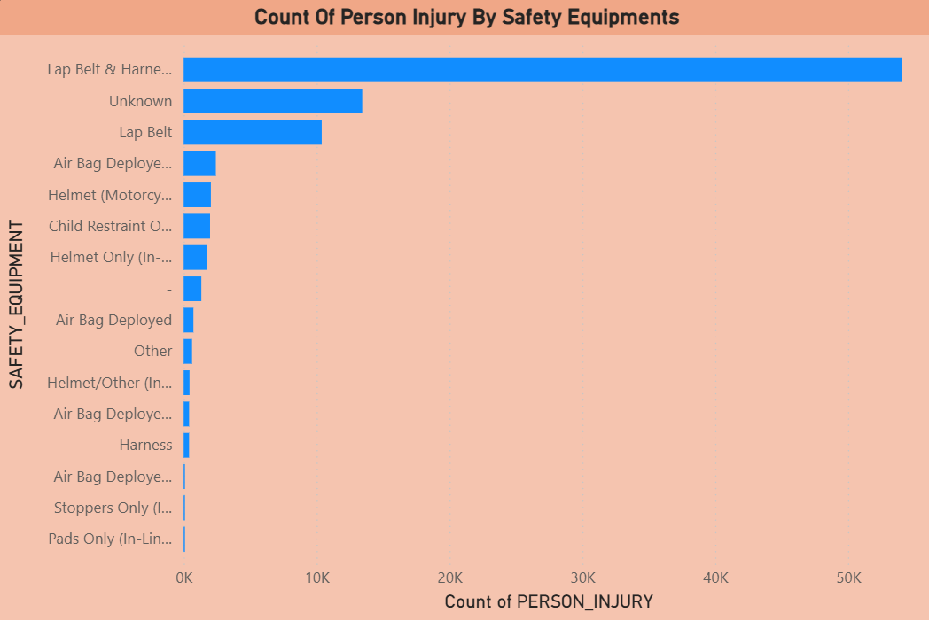
Safety Equipment Analysis
✅ Total Accidents by Safety Equipment ✅ Count of Person Injury by Safety Equipment

Slide 9
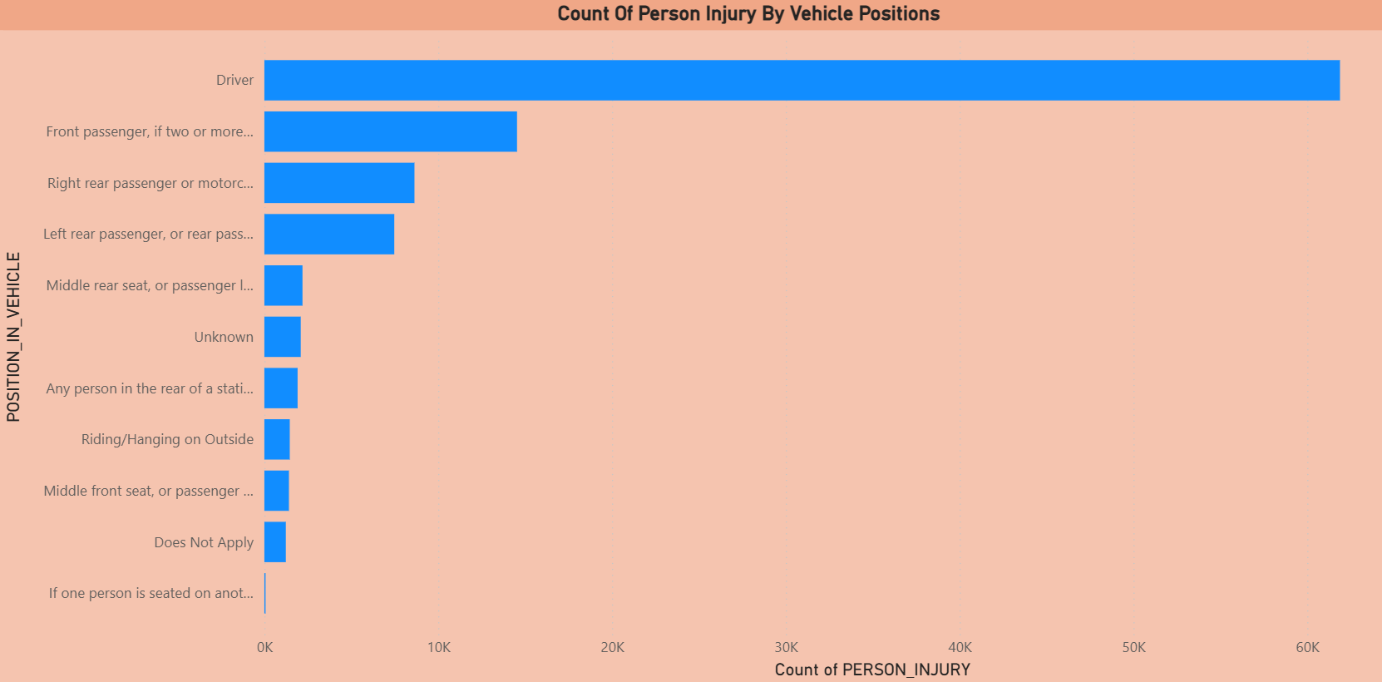
Vehicle Position Risk Analysis
✅ Count of Person Injury by Vehicle Positions

Slide 10
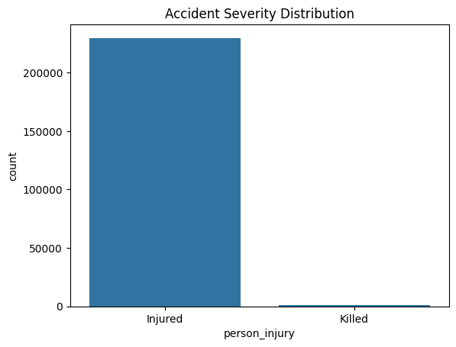
Machine Learning Approach
Problem Type: Binary Classification
Models used:
Logistic Regression
Random Forest
Gradient Boosting
Techniques applied:
Missing value imputation
One-Hot Encoding
Feature scaling
SMOTE for imbalance

Slide 11
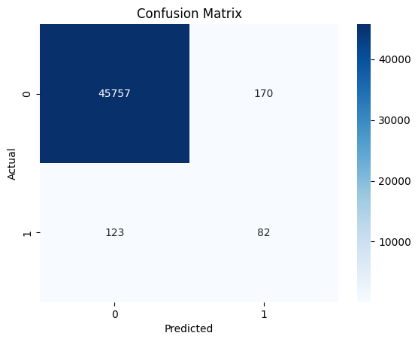
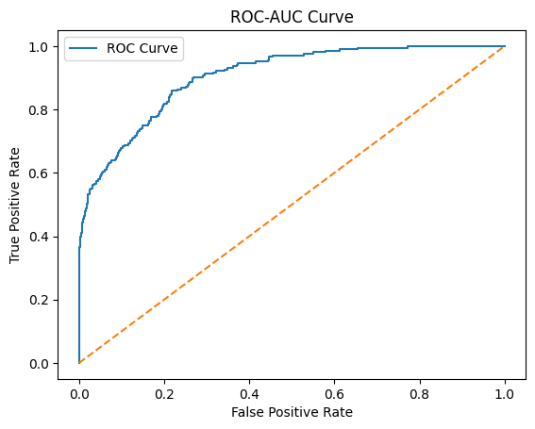
Model Performance Comparison
Model Performance Evaluation – Logistic Regression
Model Details
Algorithm: Random Forest Classifier
Problem Type: Binary Classification
Target Variable: Accident Severity
0 → Injured
1 → Killed (Fatal)
Imbalance Handling: SMOTE + Recall Optimization
Class | Precision | Recall | F1-Score | Support
Injured (0) | 1.00 | 1.00 | 1.00 | 45927
Killed (1) | 0.33 | 0.40 | 0.36 | 205
Accuracy |  |  | 0.99 | 46132
Macro Avg | 0.66 | 0.70 | 0.68 | 46132
Weighted Avg | 0.99 | 0.99 | 0.99 | 46132

Slide 12
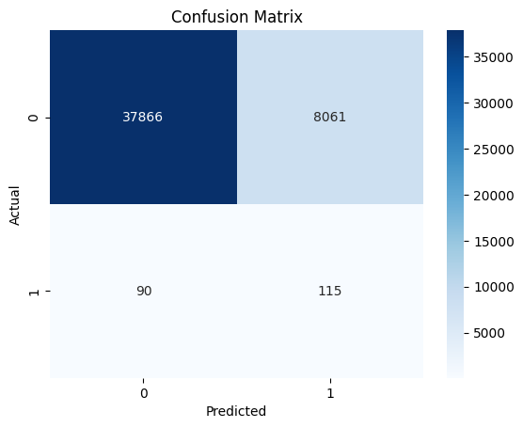
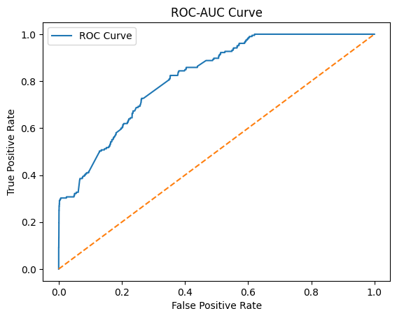
Model Performance Comparison
Model Performance Evaluation – Random Forest
Class | Precision | Recall | F1-Score | Support
Injured (0) | 1.00 | 0.82 | 0.90 | 45927
Killed (1) | 0.01 | 0.56 | 0.36 | 205
Accuracy |  |  | 0.82 | 46132
Macro Avg | 0.51 | 0.69 | 0.47 | 46132
Weighted Avg | 0.99 | 0.82 | 0.90 | 46132

Slide 13

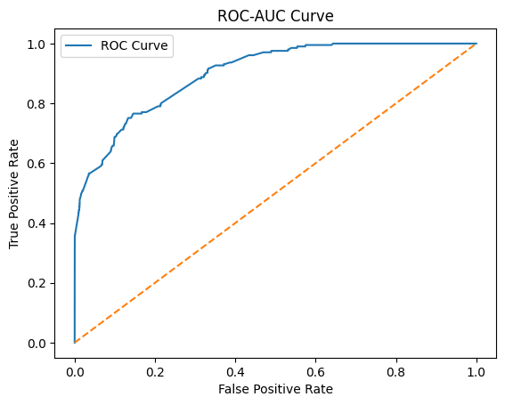
Model Performance Comparison
Model Performance Evaluation – Gradient Boosting
Class | Precision | Recall | F1-Score | Support
Injured (0) | 1.00 | 0.89 | 0.94 | 45927
Killed (1) | 0.03 | 0.70 | 0.06 | 205
Accuracy |  |  | 0.89 | 46132
Macro Avg | 0.51 | 0.80 | 0.50 | 46132
Weighted Avg | 0.99 | 0.89 | 0.94 | 46132

Slide 14
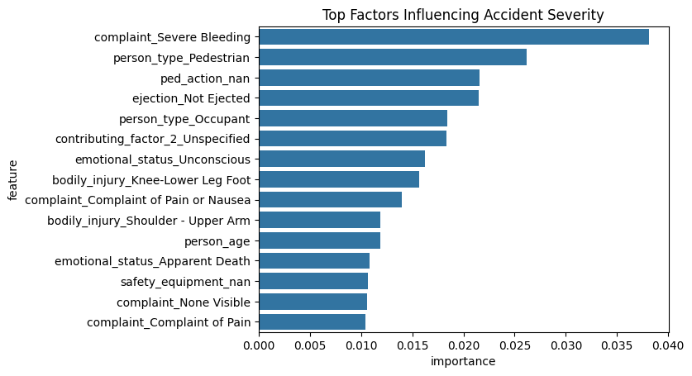
Feature Importance
✅ Top Factors Influencing Accident Severity

Slide 15
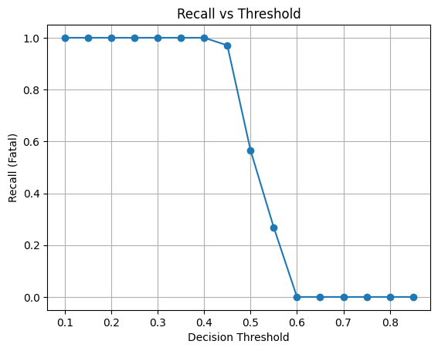
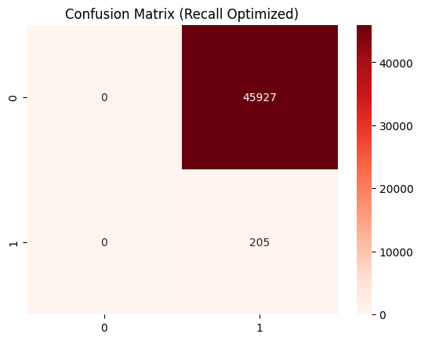
Recall Optimization
✅ Recall vs Threshold Curve ✅ Recall-Optimized Confusion Matrix

Slide 16
Final Results & Conclusion
Built end-to-end accident severity prediction system
Identified key risk factors
Optimized model for fatal case recall
Can support:
Emergency response
Road safety planning
Policy decisions

Slide 17
Future Improvements
Future Scope & Enhancements
Multi-Class Severity Prediction Extend the model to predict multiple severity levels instead of binary classification.
Incorporating External Data Sources Add weather conditions, road type, and traffic density to improve prediction accuracy.
Real-Time Accident Severity Prediction Deploy the model using APIs for real-time accident risk assessment.
Advanced Machine Learning Models Experiment with XGBoost, LightGBM, or deep learning techniques for better performance.
Explainable AI (XAI) Use SHAP or LIME to improve model interpretability for decision-makers.

